Slide 1
SSL (Secure Sockets Layer) for Library Software with Reference to Free SSL Certificate
Mohan Raj Pradhan
Chairman, HealthNet Nepal
and Secretary VuFind Software
M.Jayakananthan
Research Data Librarian
International Water Management Institute
CGIAR Centre, Sri Lanka

Slide 2
Introduction
In library software, username and password is required to access data.
In most of the developing countries like Nepal, the protocol being used is http for accessing database online.
This protocol was invented 30 years back and uses the technology: client–server model.
But any data being sent through http is open and can be manipulated by third party before it reaches to the destination i.e. server.

Slide 3
Introduction…
HTTPS (Hyper Text Transfer Protocol Secure) requires a TLS (Transport Layer Security) certificate to be installed on the server.
Certificates can be applied to different protocols, like HTTP (web), SMTP (email) and FTP.
An SSL or TLS certificate works by storing randomly generated keys (public and private) in a server.
The public key is verified with the client and the private key is used in the decryption process.

Slide 4
Introduction…
HTTP is just a protocol, but when paired with TLS it becomes encrypted.
When HTTP is combined with TLS, it is called HTTPS. This is the secure version of HTTP.
HTTPS appears in the URL. Symbolically, https is shown through a padlock icon or lock icon:

Slide 5
Introduction…
In this study, the discussion is limited to free SSL certificate due to its availability free of cost and suitable to library software in developing countries like Nepal.
Free SSL certificate provides the same level of encryption as the paid ones.

Slide 6
Introduction…
Free SSL certificates fit into two categories : “Self-Signed Certificates” and “certificate authority (CA)”
‘Self-Signed Certificates’ are the ones in which there is no need for any Certificate Authority to sign them.
They are signed by the issuer him/herself.
This type of certificate is used for IP address whether private or public.
It may be appropriate if domain name associated with the server is not available and have only IP address.

Slide 7
Introduction…
“certificate authority (CA)” is the another free SSL certificate signed by certificate authority and it is limited to domain validated.
If domain name is available. It is better to use Certificate Authority (CA)-signed certificate.

Slide 8
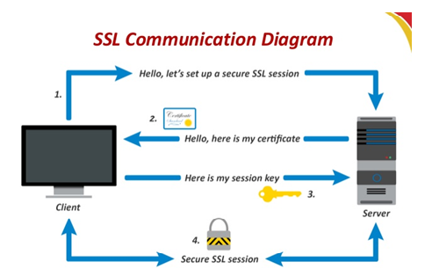
The following is a standard SSL handshake when RSA key exchange algorithm is used:
Figure 1 : SSL Communication Diagram
(Source: https://www.mike-irving.co.uk/web-design-blog/?blogid=100)

Slide 9
Prerequisites
Debian 11 installed on Server (can be virtual or dedicated — doesn’t matter)
SSH with sudo or root access
Comfort with linux commands
Port 80 and 443 allowed on firewall/iptables

Slide 10
Materials and methods
Self-Signed Certificate for Apache2
As a prerequisite, a non-root user configured with sudo privileges and apache web server are needed.
In this presentation, we are focusing on certificate authority signed free SSL with reference to Let’s encrypt.
The procedures for creating free SSL certificates for the following software will be presented:
Koha ILS, DSpace, VuFind and WordPress.

Slide 11
Step 1 — Configuring Apache to Use SSL
The key and certificate files are saved under the /etc/letsencrypt directory. Apache configuration has to be modified to take advantage of these.
The adjustment to the configuration file is made as follows:
Creating a configuration snippet to specify strong default SSL settings.
Modify the included SSL Apache Virtual Host file to point to the generated SSL certificates.

Slide 12
Step 2 — Enabling the Changes in Apache
Instance name has to be created in /etc/apache2/sites-available<instance-name>.
In some software package, it is automatically created while installing the software such as Koha ILS, Dspace, and WordPress.
If the instance name file is not being created at the time of installation. It has to be created manually with the command:
sudo nano /etc/apache2/sites-available/<instance-name>

Slide 13
Commands to be run to enable the new virtualhost
The following commands have to be run inside the directory : /etc/apache2/sites-available
sudo a2ensite <virtual-host>
This will enable the new virtualhost
sudo a2enmod rewrite
This will enable the rewrite
sudo systemctl restart apache2.service
Restart apache web server to allow all changes to take place.

Slide 14
If there is no syntax error, the configtest can be done, with the following command:
#sudo apache2ctl configtest
The following result will be displayed, if everything is successful:
Output
Syntax OK
:

Slide 15
Software to be used
There are two types of software for creating SSL through Let’s Encrypt. One is snap and the other is python3-certbot-apache.
They are the same application, but different methods of distributing. The certbot team recommends using snap, as it will be most up to date.
Using the snap distribution method will give the best chance of best compatibility in the future

Slide 16
Step1: Step-by-step instructions to install Certbot on Debian 11 through snap software

Slide 17
Step 1. Install snapd
doe@localhost:~$ sudo apt update doe@localhost:~$ sudo apt install snapd
Once snapd is installed, exit the ssh terminal and re-login to ensure snap’s paths are updated properly.
Step 2. Update snapd
Once you are back on the terminal, install the core snap to ensure the latest version of snapd is installed. Execute the following command:
doe@localhost:~$ sudo snap install core
Step 3. Remove previous Certbot packages
Before installing Certbot snap, you need to ensure any previous installations of Certbot packages are completely removed from the server. You can do so by executing this command:
doe@localhost:~$ sudo apt-get remove certbot

Slide 18
Step 4. Install Certbot
The following command will install Certbot:
doe@localhosti:~$ sudo snap install --classic certbot
Once certbot is installed, execute the following command to ensure the ‘certbot’ command can be run:
doe@localhost:~$ sudo ln -s /snap/bin/certbot /usr/bin/
certbotdoe@localhost:~$ sudo certbot --apache
(After execute this last command, the setup will ask you for your domain namewhat you need a SSL for).
Notes:
Reading package lists... Done
Building dependency tree... Done
Reading state information... Done
The following packages were automatically installed and are no longer required:
augeas-lenses libaugeas0 python3-acme python3-augeas python3-certbot python3-configargparse
python3-configobj python3-icu python3-josepy python3-parsedatetime python3-rfc3339 python3-tz
Use 'sudo apt autoremove' to remove them.
The following packages will be REMOVED:
certbot python3-certbot-apache
0 upgraded, 0 newly installed, 2 to remove and 151 not upgraded.
After this operation, 496 kB disk space will be freed.
Do you want to continue? [Y/n]

Slide 19
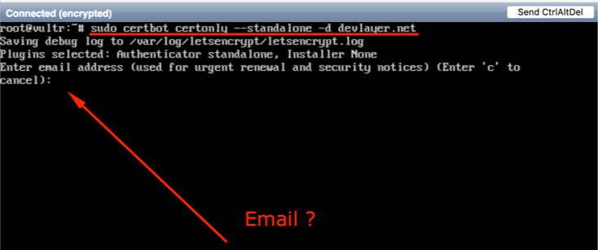
Certbot asks to enter email, which is necessary so that Let's Encrypt organization notifies at the time of updating the certificate or notices related to confidentiality.

Slide 20
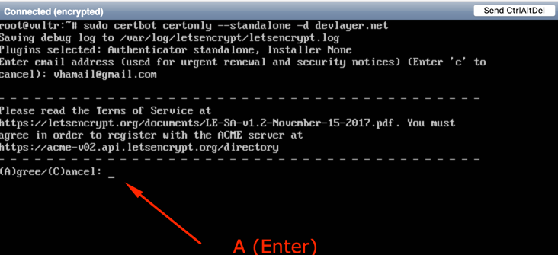
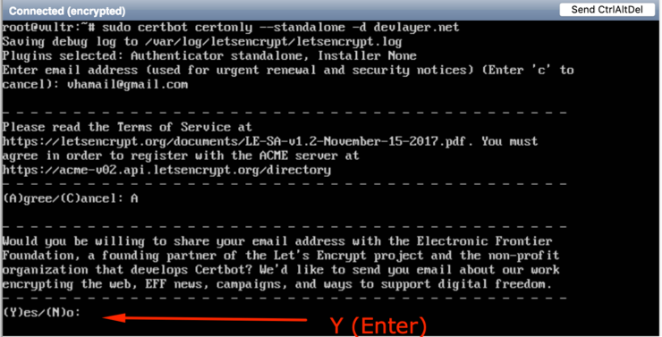
Agree about the terms of Let's Encrypt:

Slide 21
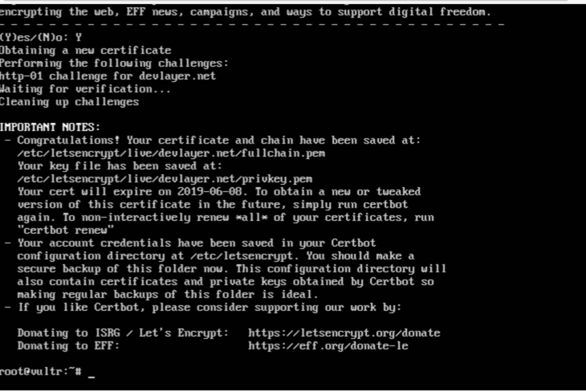
Now, a directory containing SSL certificate information has been created on the server being used in the directory: /etc/letsencrypt as follows:
/etc/letsencrypt
/etc/letsencrypt/live/{yourdomain.com}

Slide 22
Step by step instructions are given to create ssl for the following software:
Koha ILS, WordPress, VuFind and DSpace.

Slide 23
Installing SSL with Let’s Encrypt in Koha ILS
Koha is widely used open source software in library automation.
By default, Koha has only one configuration file in the directory: /etc/apache2/sites-enabled/<instance>
We can create ssl with one file <instancename.conf> or we can create ssl by splitting the opac and admin parts into separate files as given in table of the next slide:

Slide 24
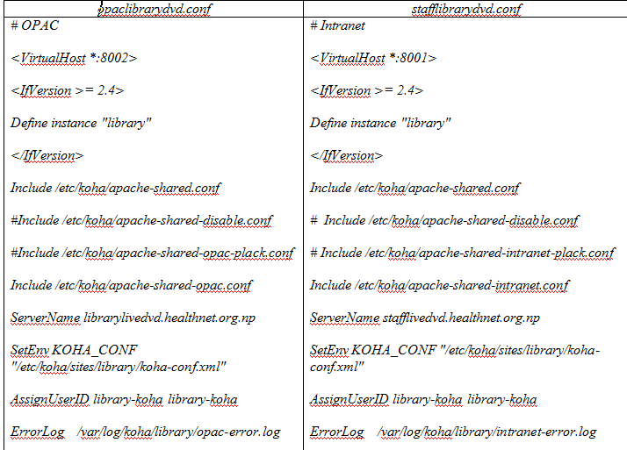
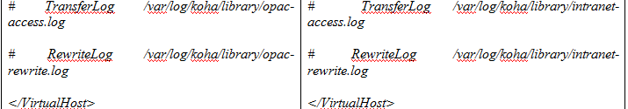
Example: library.conf contains both opac as well as admin config file as follows:

Slide 25
Make the aforementioned file into two parts:
one related to opac named opaclibrarydvd.conf
and another one Intranet named as stafflibrarydvd.conf and should be created in the directory/etc/apache2/sites-available.
Run the following commands to create simlinks in the directory /etc/apache2/sites-enabled:
#sudo a2ensite opaclibararydvd.healthnet.org.np
# sudo a2ensite stafflibararydvd.healthnet.org.np
sites-enabled.

Slide 26
To create SSL through let’s encrypt, run the following command:
# sudo wget https://dl.eff.org/certbot-auto -O /usr/sbin/certbot-auto
# sudo chmod a+x /usr/sbin/certbot-auto
#sudo certbot-auto --apache -d opaclibararydvd.healthnet.org.np
#sudo certbot-auto --apache -d stafflibrarydvd.healthnet.org.np

Slide 27
The domain name opaclibrarydvd.healthnet.org.np and stafflibrarydvd.healthnet.org.np should be replaced by the actual domain name.
The above command will redirect the:
http:// stafflibrarydvd.healthnet.org.np:8001 >> https:// stafflibrarydvd.healthnet.org.np
http:// opaclibararydvd.healthnet.org.np:8002 >> https:// opaclibararydvd.healthnet.org.np

Slide 28
Installing SSL with Let’s Encrypt in WordPress
Installing SSL with Let’s Encrypt in WordPress using the software python3-certbot-apache
Create virtual host file in /etc/apache2/sites-available with the following information through an editor:
#sudo vim /etc/apache2/sites-available/wordpress.conf
Create or paste the following information:
Instead of mydomain.com, actual domain name can be written and in the DocumentRoot actual path of the wordpress folder should be given.

Slide 29
<VirtualHost *:80>
ServerAdmin admin@mydomain.com
ServerName mydomain.com
ServerAlias www.mydomain.com
DocumentRoot /var/www/html/wordpress
ErrorLog ${APACHE_LOG_DIR}/mydomain.com_error.log
CustomLog ${APACHE_LOG_DIR}/mydomain.com_access.log combined
</VirtualHost>

Slide 30
To enable the virtual host just created, run the following command:
#sudo a2ensite wordpress.conf
#sudo a2enmod rewrite
Restart Apache2 with the following command:
#sudo service apache2 restart

Slide 31
a2ensite script enables the specified site (which contains a <VirtualHost> block) within the apache2 configuration.
If no error is displayed, it will create symlinks within /etc/apache2/sites-enabled
Setting up Let's Encrypt SSL certificate on Apache for WordPress
It is run under the folder:/etc/apache2/sites-enabled
# sudo certbot –apache
It will provide list of domain names to be created. You have to select the appropriate one.

Slide 32
Installing SSL with Let’s Encrypt in VuFind
Create the virtual host in the directory: /etc/apache2/sites-available as follows:
<VirtualHost *:80> ServerAdmin pradhmohan@gmail.com ServerName vufind.healthnet.org.np ServerAlias www.vufind.healthnet.org.np DocumentRoot /usr/local/vufind ErrorLog /var/log/apache2/error.log </VirtualHost>
Port was given:80 as mentioned above instead of 9090

Slide 33
Run the following commands to create simlinks in the directory /etc/apache2/sites-enabled:
sudo a2ensite vufind.conf
Run the following command to create SSL :
sudo certbot --apache
Note: The domain vufind.healthnet.org.np and serveradmin pradhmohan@gmail.com should be replaced by the actual domain name.

Slide 34
Enable SSL in Dspace 7.6 with Certbot
Basic Requirements
To ensure that DSpace 7 operates on a custom domain name, it is necessary to activate HTTPS on the backend.
To get entry to your account you should be using HTTPS protocol. This applies to all users, including administrators as well.
This presentation explain DSpace version 7.6, with both the backend and frontend components hosted on the same server.
Ensure that Solr and Tomcat are functioning correctly.
Check your angular-based frontend. http://localhost:4000
Check your backend/REST API. http://localhost:8080/server
Obtain/register your domain name (DNS).

Slide 35
Installation Process
Install Apache2
sudo apt-get install apache2
Verify if Apache works properly on port 80
Try to open http://yourIP (port 80)
Enable these mods in Apache2
sudo a2enmod proxy_http ssl headers
sudo systemctl restart apache2

Slide 36
Use Certbot to get & install an SSL certificate for your domain
Follow the steps
sudo apt install snapd
sudo apt install snap
sudo snap install core
sudo snap refresh core
sudo snap install --classic certbot
sudo ln -s /snap/bin/certbot /usr/bin/certbot
sudo certbot --apache
After this the screen will ask you for your domain name
sudo systemctl restart apache2

Slide 37
Create Apache configuration
Create a blank config file for your new DSpace site:
nano /etc/apache2/sites-available/dspace.conf
Edit and customize your dspace.conf file. Use your own domain name
Do not forget to change the used paths for SSL certificates
Disable old Apache Conf files
Enable your site in Apache2 and restart Apache2:
sudo a2ensite dspace.conf
Notes:
<VirtualHost *:80>
ServerName dspace76.healthnet.org.np
#automatic redirection from http to https
Redirect / https://dspace76.healthnet.org.np
</VirtualHost>
<VirtualHost *:443>
ServerName dspace76.healthnet.org.np
LogLevel warn
ErrorLog ${APACHE_LOG_DIR}/dspace76.healthnet.org.np.error.log
CustomLog ${APACHE_LOG_DIR}/dspace76.healthnet.org.np.access.log combined
ProxyRequests on
SSLEngine on
SSLProxyEngine on
#check and insert here the correct paths to your domain certs:
#If you used Certbot to install certs, the certs paths are shown here:
SSLCertificateFile /etc/letsencrypt/live/dspace76.healthnet.org.np/fullchain.pem
SSLCertificateKeyFile /etc/letsencrypt/live/dspace76.healthnet.org.np/privkey.pem
SSLCertificateChainFile /etc/letsencrypt/live/dspace76.healthnet.org.np/chain.pem
SSLCompression off
SSLProtocol all -SSLv3 -TLSv1 -TLSv1.1
SSLHonorCipherOrder off
SSLSessionTickets off
ProxyPreserveHost on
RequestHeader set X-Forwarded-Proto https
<Proxy *>
AddDefaultCharset Off
Require all granted
</Proxy>
# PROXY for backend. Keep only localhost here! not insert your domain name!
ProxyPass /server http://localhost:8080/server
ProxyPassReverse /server http://localhost:8080/server
# PROXY for frontend. Keep only localhost here! not insert your domain name!
ProxyPass / http://localhost:4000/
ProxyPassReverse / http://localhost:4000/
</VirtualHost>

Slide 38
Dspace Configuration
Edit the DSpace backend settings
sudo nano /dspace/conf/local.cfg

Slide 39
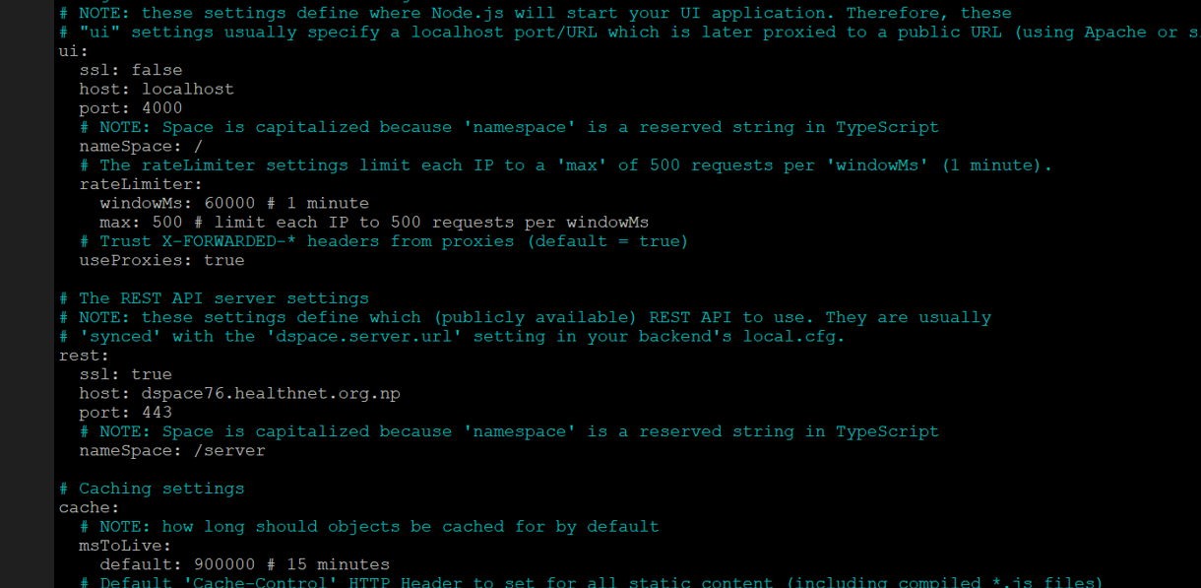
Dspace Configuration
Frontend production config file
cd /home/dspace/dspace-angular-dspace-7.6/config/
nano config.prod.yml

Slide 40
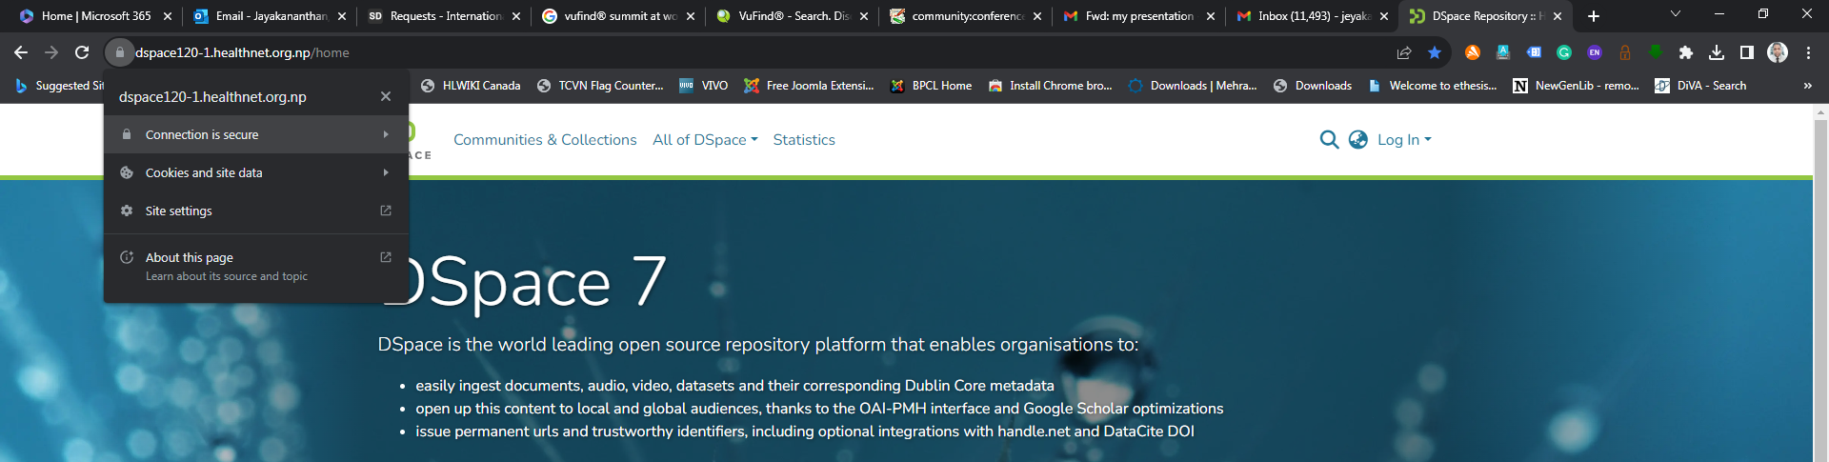
Dspace Configuration
restart frontend via pm2:
pm2 stop /home/dspace/dspace-angular-dspace-7.6/dspace-ui.json
then start it again by:
pm2 start /home/dspace/dspace-angular-dspace-7.6/dspace-ui.json
now available at https://yourdomain

Slide 41
Renewal of the SSL certificates
The certificate created through let’s encrypt is valid for 90 days only.
Before expiry, let’s encrypt will send notice 30 days earlier.
The certificate can be renewed with the following command. With this command all the certificate due for renew will be renewed.
#certbot renew
The command can also be put into cronjob like this:
# sudo crontab –e
Add the below command at end of file and save it. It will run every day at 1 am.
1 * * * /usr/bin/certbot-auto renew

Slide 42
Conclusion
In this study, process has been given to create domain validated certificates for apache tomcat used for DSpace, Let’s encrypt for Apache used in Koha ILS, WordPress, and VuFind.
All these procedures help to create SSL free of cost which may be helpful for library professionals in developing countries or to those library organizations who want ssl free of cost.

Slide 43
References
Ellingwood, Justin, Boucheron, B. and D. M. (2018). How to create a self-signed SSL certificate for Apache in Debian 9. Retrieved February 1, 2020, from https://www.digitalocean.com/community/tutorials/how-to-create-a-self-signed-ssl-certificate-for-apache-in-debian-9
Follow, M. K. S. (2018). How to install Let’s Encrypt with Tomcat. Retrieved February 2, 2020, from https://medium.com/@raupach/how-to-install-lets-encrypt-with-tomcat-3db8a469e3d2
o7planning.org. (2019). Install a free SSL certificate Let’s Encrypt for Tomcat Server on Ubuntu https://o7planning.org/en/12243/install-a-free-ssl-certificate-lets-encrypt-...
SSL Renewals.com. (2020). Free SSL vs Paid SSL Certificate – Which is Right for You ? Retrieved January 30, 2020, from https://sslrenewals.com/blog/difference-between-free-ssl-certificate-and-paid-ssl-certificate

Slide 44
Thank you

